Slide 1
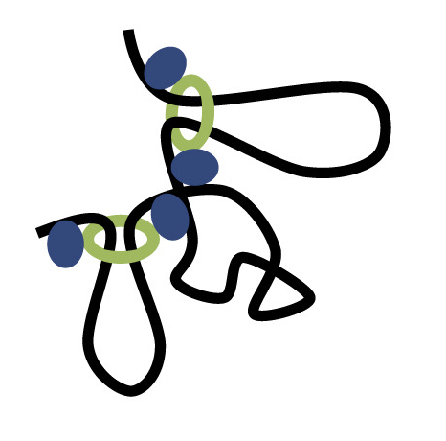

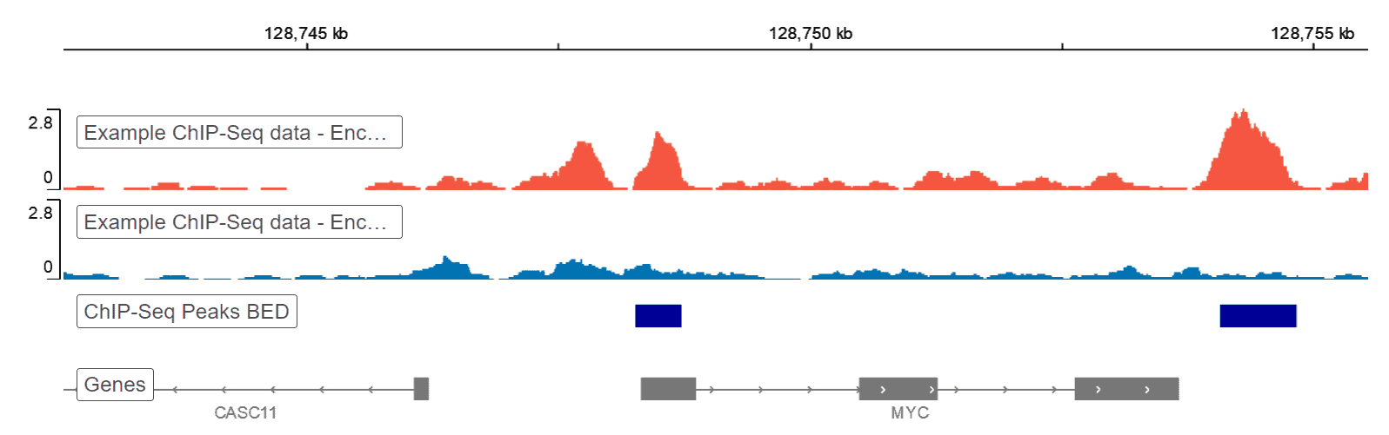
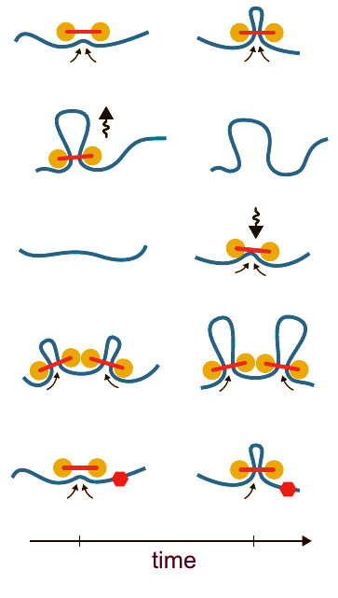
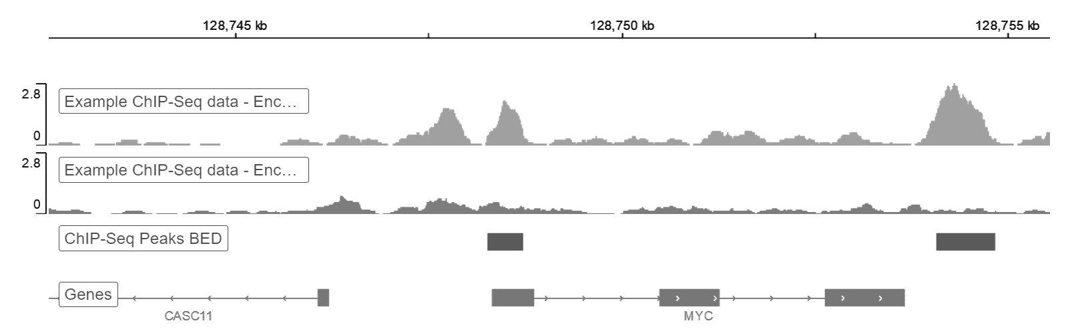
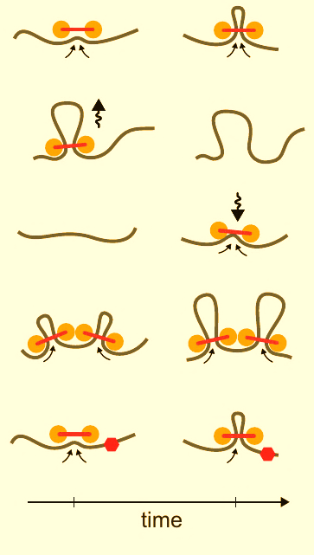
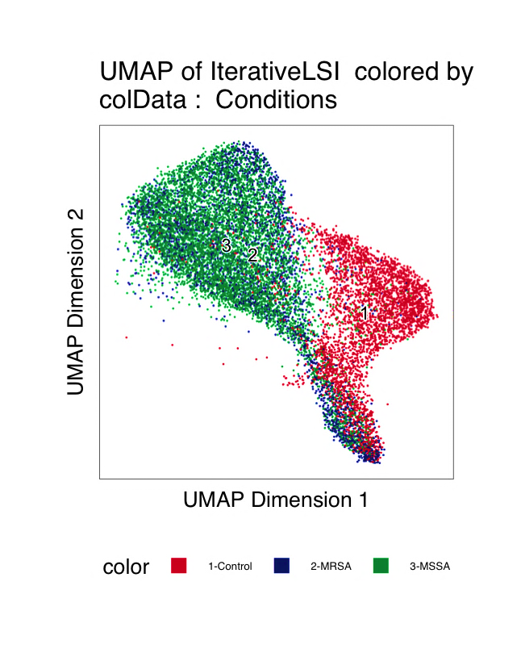
Disease-associated regulation
3D genome
scATAC-seq
Distal regulation
scRNA-seq
Post-exposure
Accessible
chromatin site
Activated
expression
TFs
Gene
Pre-exposure
Inaccessible
chromatin site
Baseline
expression
Gene
MAGICAL
sc multi-omics data
Hierarchical Bayesian estimation
3D regulatory triad
Post-exposure and pre-exposure
differential analysis
for one cell type
TF activity
TF-Peak binding
Prior
(TF1 –> Peak 2 –> Gene 1)
T
B
Motif
TF1
TF2
scATAC-seq
ATAC
Peak-Gene looping
Prior
Candidate peaks
A
L
TAD
Peak 1
Peak 2
Peak 3
Data input
scRNA-seq
RNA
Variable causality
R
A = BT + error_{A}
Candidate genes
R = LBT + error_{R}
Gene 1
Gene 2

Slide 2
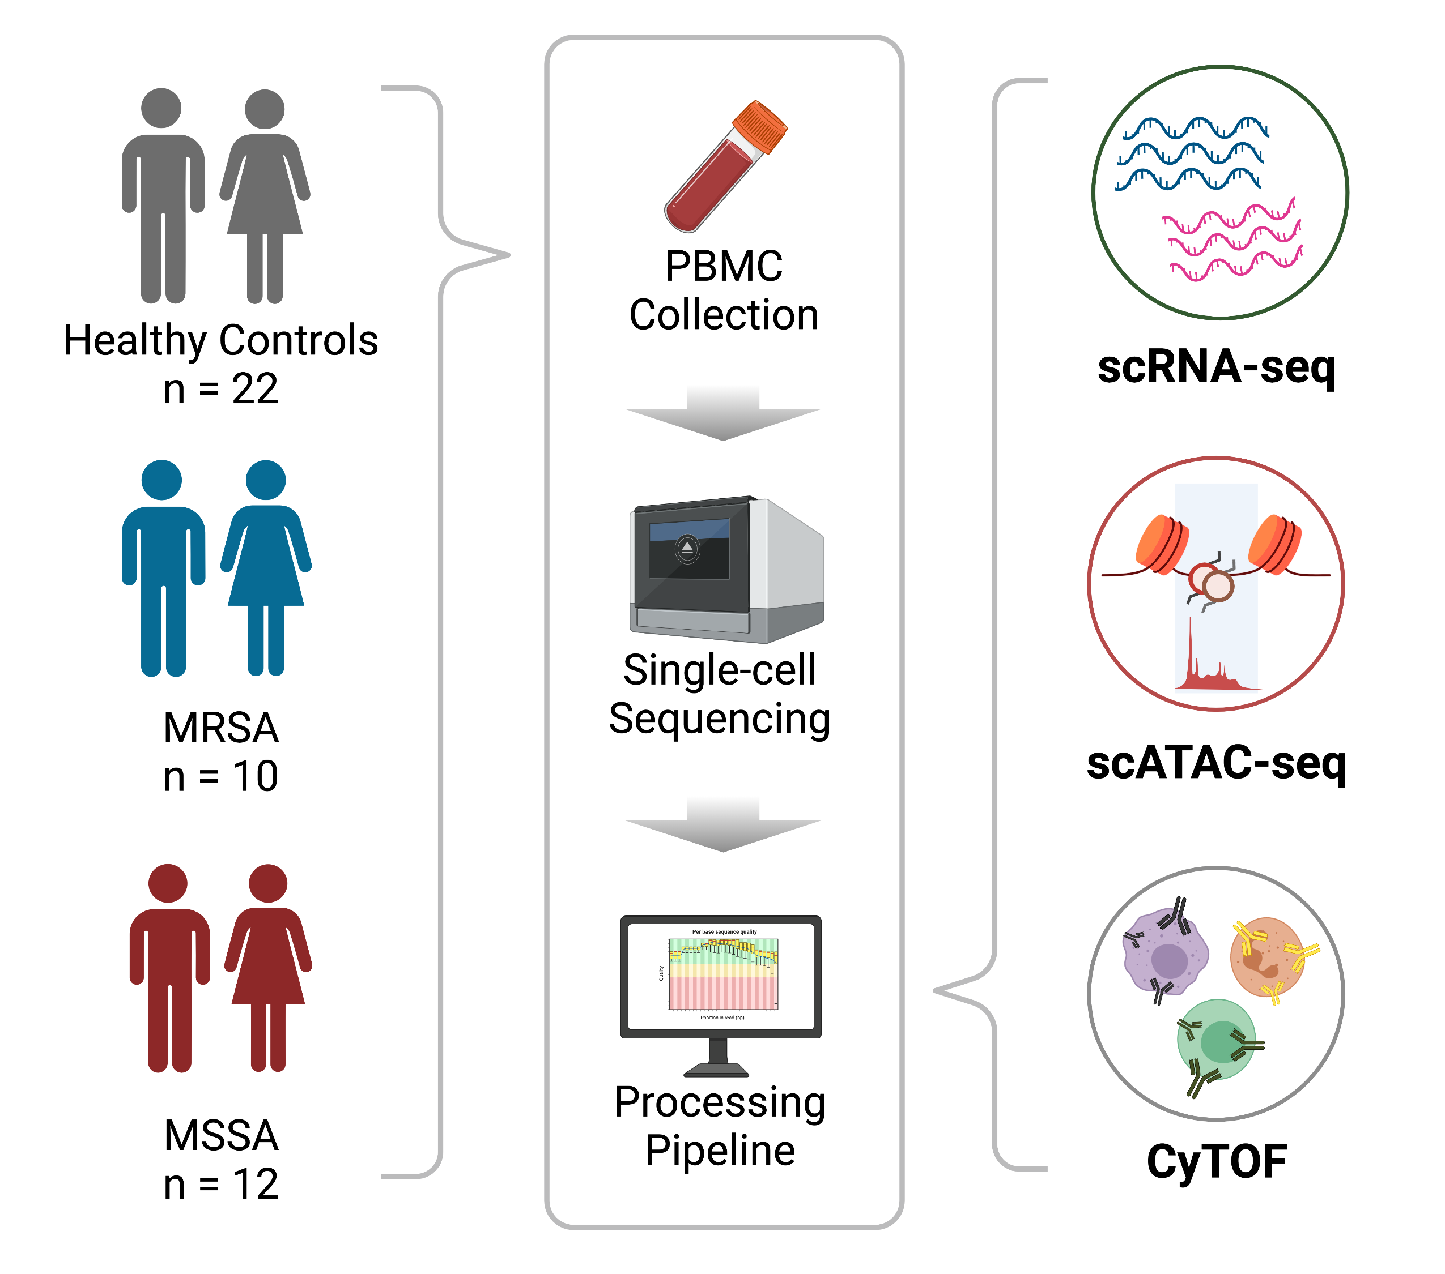
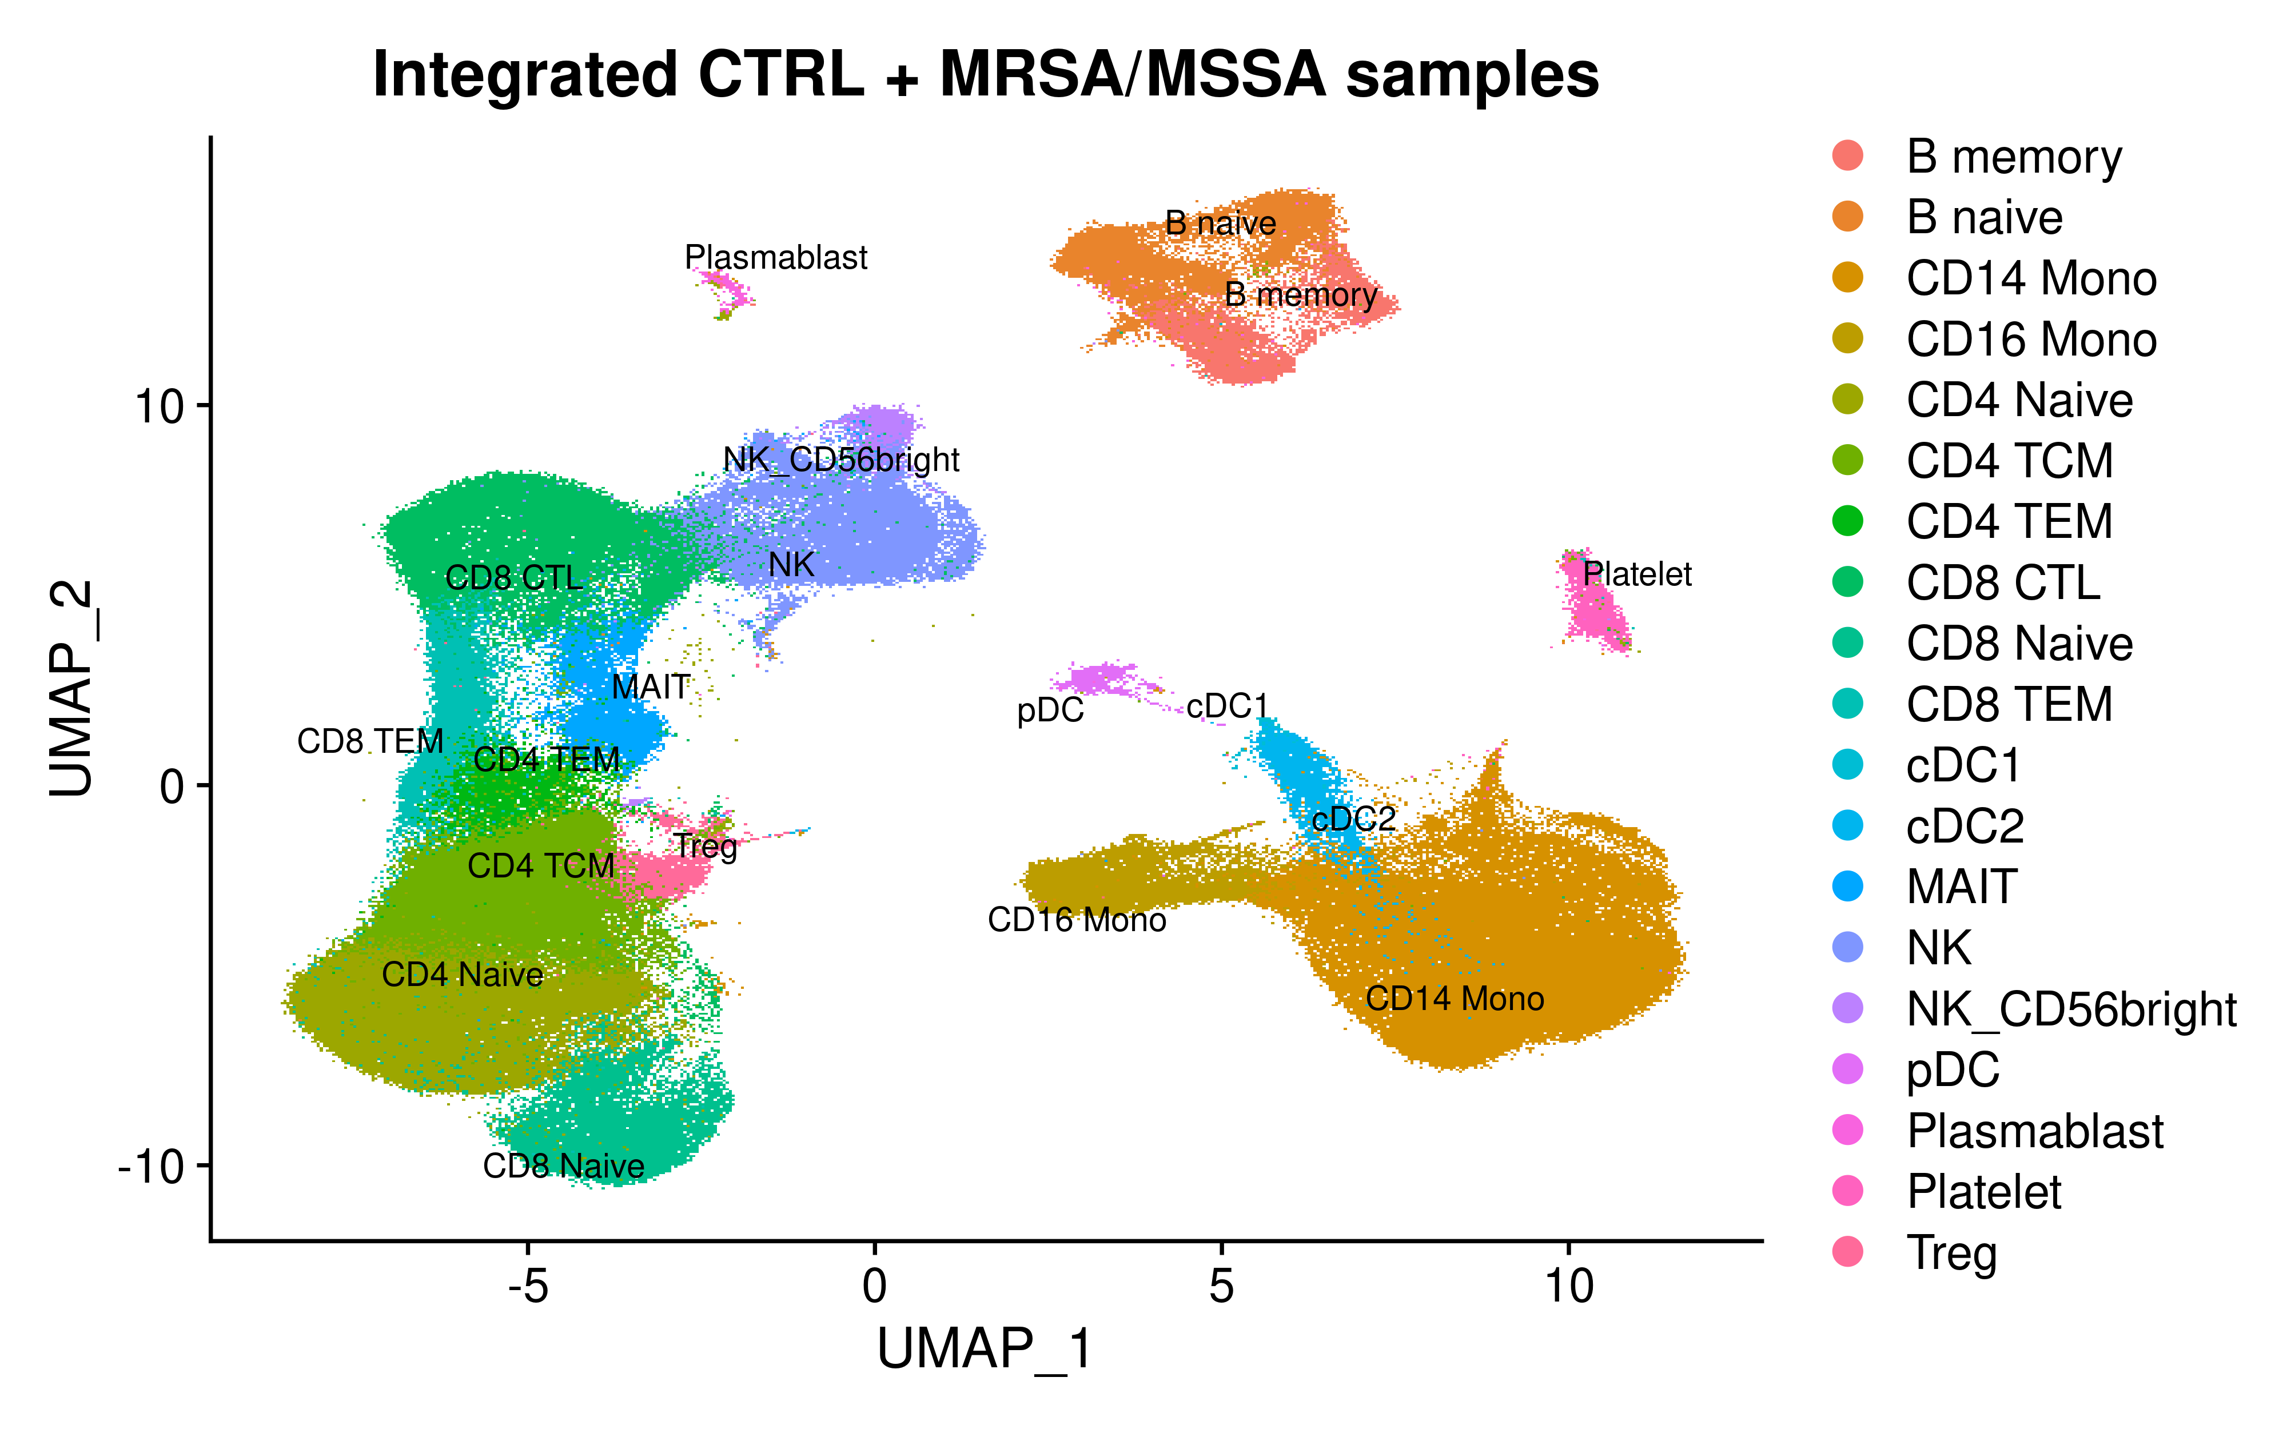
Staph infection single cell multi-omics data analysis workflow
scRNA-seq (277K cells)
scATAC-seq (70K cells)
1. Cell, 184 (13), 3573-3587 (2021)
2. https://azimuth.hubmapconsortium.org/
3. Nature Genetics, 53, 403–411 (2021)

